Slide 1
Estimates for Bayesian Inference with Doubly-Intractable Likelihoods

Slide 2

Contents
I. Ising Lattice spin models
II. Simulating $Y_{n}$ from $p\left(\left.y\right|α,β\right)$using Gibbs-sampler
III. Simulating $β_{n}$for $p\left(β|y\right)$ using an exchange algorithm, assuming $α=0$

Slide 3
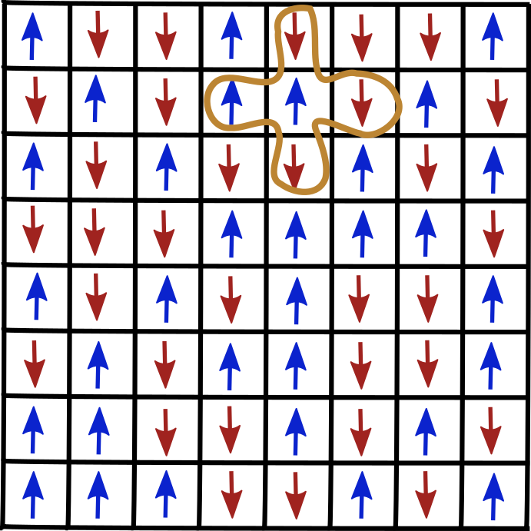

I. Ising Lattice spin models
For a grid y,
$p\left(\left.y\right|α,β\right)= \frac{1}{Z\left(α,β\right)}exp(α\sum_{i}^{N^{2}}{y_{i}}+β\sum_{k\sim i}{y_{i}y_{k}})$,
where $Z\left(α,β\right)$ is the normalization constant that requires a sum over all $2^{N^{2}}$possible grids!
We apply the periodic boundary conditions : each site has four neighbours even on the sides

Slide 4


II. Simulating from using Gibbs-sampler – why ?
Gibbs sampling is a MCMC method. It will allow us to sample grids.
Here, our desired distribution is :
Z is the normalising constant :
Problem : Z is hard to compute ! NxN grid → 2*N² possible configurations

Slide 5



II. Simulating from using Gibbs-sampler – principle
A solution to avoid calculating Z while being able to generate a sample is using a Gibbs sampler.
We consider the conditional distribution of each spin constituting the grid.
Given parameters alpha = 0, beta = 0.2, the conditional probability of a spin is :
where sigma is the sigmoid function :
J is the matrix of neighbours, is the i-th row of the matrix (and = 1

Slide 6
II. Simulating using Gibbs-sampler – principle
The algorithm works as below :
Given a grid and a number N of iterations, at each step of the algorithm :
i) Pick randomly an index i of the grid (uniform distribution)
ii) Compute the conditional probability P of the spin i
iii) Generate a number U between 0 and 1 (uniform distribution)
iv) If U ≤ P → set the spin y_i equal to 1, otherwise set it to –1
Repeat the loop N times.
At the end, we have a sample (one grid). The distribution of the grid can be consideered as the desired distribution if the number of iterations is important (due to the convergence to the desired distribution).

Slide 7
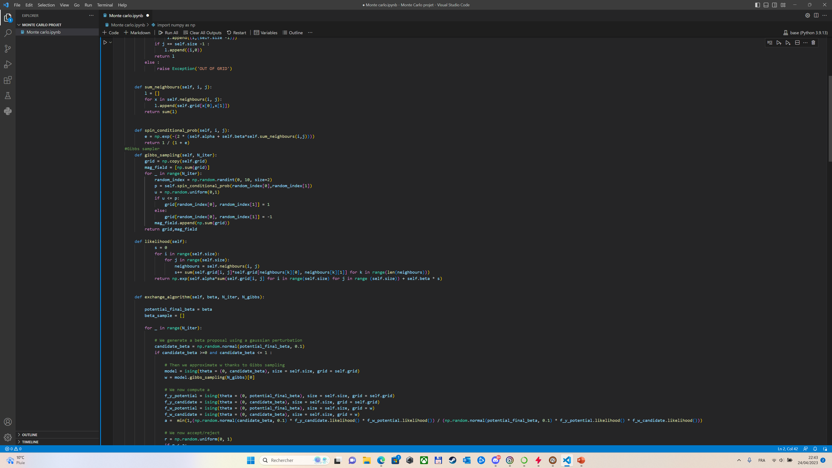
II. Simulating using Gibbs-sampler – code
Initiation
Computations
Loop
Assignation

Slide 8
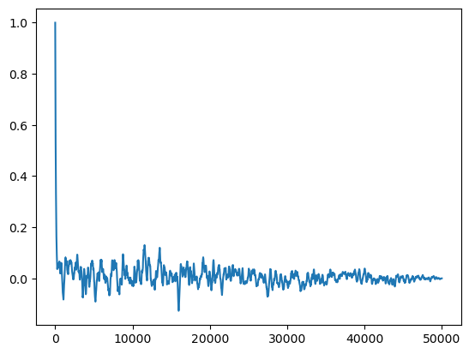
II. Simulating using Gibbs-sampler – autocorrelations
We use the mag_field (sum of the spins) output of the sampler to compute the autocorrelations and check the shape
Measurements were conducted for 50000 iterations of the sampler

Slide 9

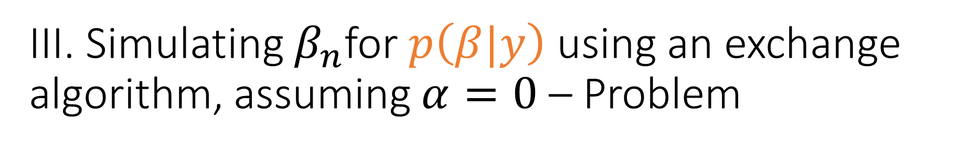
III. Simulating $β_{n}$for $p\left(β|y\right)$ using an exchange algorithm, assuming $α=0$ – Problem
Using simple Metropolis-Hastings algorithms will not work here!
We have : $p\left(β|y\right)=\frac{f\left(y;β\right)}{Z\left(β\right)}p\left(β\right)$ where we assume that p is a simple distribution
The Metropolis-Hatings algorithm would require us to compute the
acceptance rate : $a=\frac{p\left(β^{′}|y\right)q(β;β^{′},y)}{p\left(β^{′}|y\right)q(β^{′};β,y)}=\frac{q(β;β^{′},y)f\left(y;β^{′}\right)p\left(β^{′}\right)}{q(β^{′};β,y)f\left(y;β\right)p\left(β\right)}\frac{Z(β)}{Z(β^{′})}$
which we can’t because of the $\frac{Z(β)}{Z(β^{′})}$ term!

Slide 10

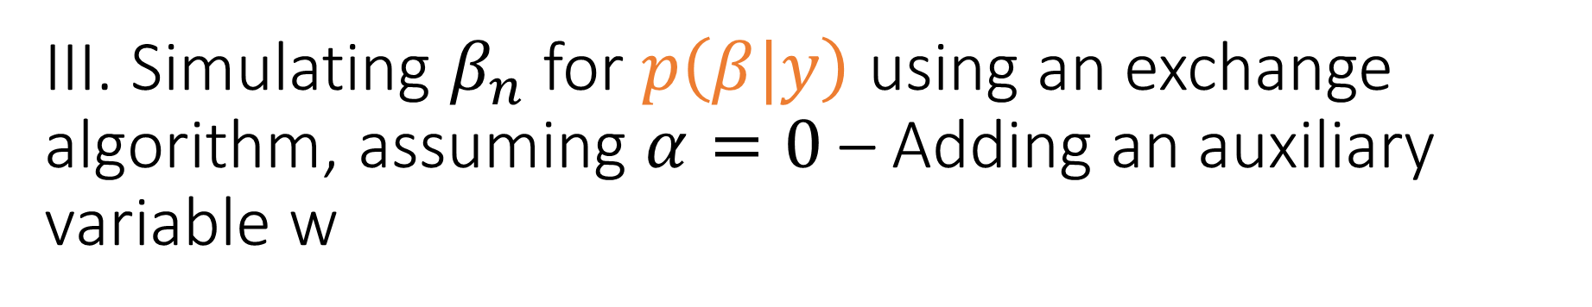
III. Simulating $β_{n}$for $p\left(β|y\right)$ using an exchange algorithm, assuming $α=0$ – Adding an auxiliary variable w
We extend the joint distribution by adding an auxialiary variable x, which shares the same state space as y :
$p\left(x,y,β\right)=p(x;y,β)\frac{f\left(y;β\right)}{Z\left(β\right)}p\left(β\right)$
Note that $p\left(y,β\right)$ remains unchanged
Using a M-H algorithm, the acceptance rate for $\left(x,β\right)→(x′,β^{′})$ is :
(i) $a=\frac{p\left(x′,β^{′}|y\right)q(x,β;β^{′},y)}{p\left(x,β|y\right)q({x′,β}^{′};β,y)}$
A convenient form for q is such that (ii) $q\left({x^{′},β}^{′};β,y\right)=q\left(β^{′};β,y\right)q(x^{′};$ $β^{′})$
Choose the usual proposal $β^{′}$ from $q\left(β^{′};β,y\right)$, followed by a proposal of $x^{′}$ from$q(x^{′};$ $β^{′})$

Slide 11

III. Simulating $β_{n}$for $p\left(β|y\right)$ using an exchange algorithm, assuming $α=0$ – Adding an auxiliary variable w
By choosing (iii) $q(x^{′};$ $β^{′})=\frac{f\left(x^{′};β^{′}\right)}{Z\left(β^{′}\right)}$ (which we know how to simulate via part II), the M-H acceptance ratio becomes :
(i) $a=\frac{p\left(x′,β^{′}|y\right)q(x,β;β^{′},y)}{p\left(x,β|y\right)q({x′,β}^{′};β,y)}$
(ii) $a=\frac{p\left(x^{′}|β^{′},y\right)}{p\left(x|β,y\right)}\frac{p\left(β^{′}|y\right)}{p\left(β|y\right)}$ $\frac{q(x;β)}{q(x^{′}; β^{′})}\frac{q\left(β;β^{′},y\right)}{q\left(β^{′};β,y\right)}$
(iii)+ (*) $a=\frac{p\left(x^{′}|β^{′},y\right)}{p\left(x|β,y\right)}\frac{Z(β)f\left(y;β^{′}\right)p\left(β\right) }{Z(β^{′})f\left(y;β\right)p\left(β^{′}\right)}$ $\frac{f\left(x;β\right)Z(β^{′})}{f\left(x^{′};β^{′}\right)Z(β)}\frac{q\left(β;β^{′},y\right)}{q\left(β^{′};β,y\right)}$
$a=$ $\frac{f\left(y;β^{′}\right)p\left(β\right) }{f\left(y;β\right)p\left(β^{′}\right)}$ $\frac{q\left(β;β^{′},y\right)}{q\left(β^{′};β,y\right)}\frac{p\left(x^{′}|β^{′},y\right)}{p\left(x|β,y\right)}$ $\frac{f\left(x;β\right)}{f\left(x^{′};β^{′}\right)}$
No more $\frac{Z(β)}{Z(β^{′})}$ term!

Slide 12
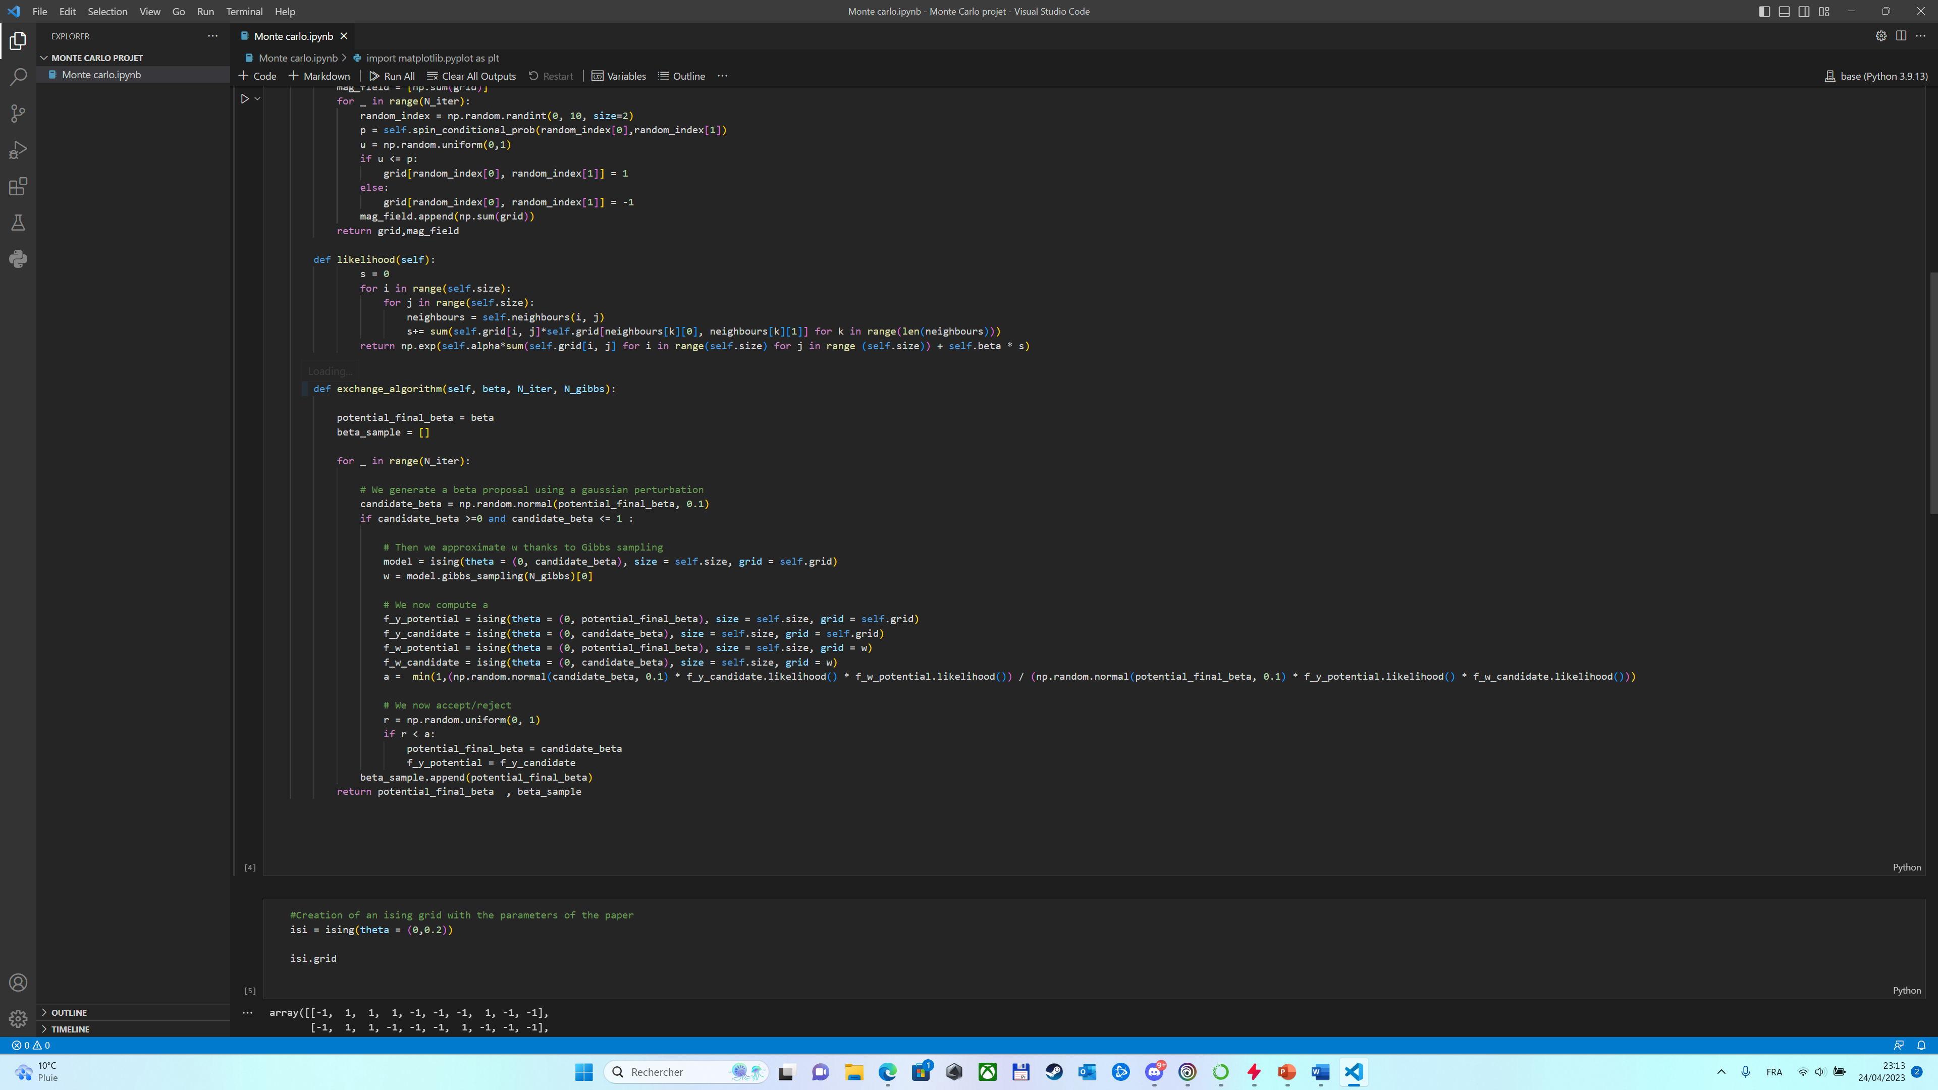
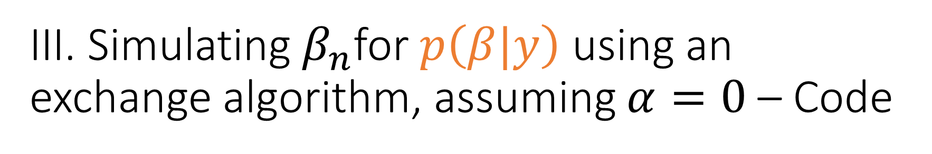
III. Simulating${ β}_{n}$for $p\left(β|y\right)$ using an exchange algorithm, assuming $α=0$ – Code
Generation of a new candidate for beta
Generation of auxiliary variable
Loop
Computation
Accept/reject step

Slide 13
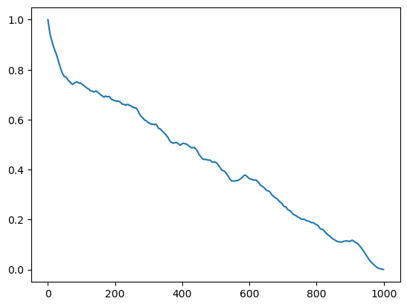

III. Simulating $β_{n}$for $p\left(β|y\right)$ using an exchange algorithm, assuming $α=0$ – Autocorrelations
We plot the autocorrelations of the exchange algorithm to check the shape
Measurements were conducted on 1000 iterations with 50000 iterations for the gibbs sampler inside the exchange algorithm

Slide 14
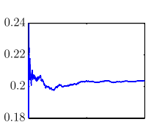
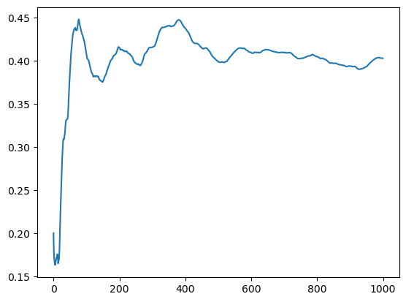
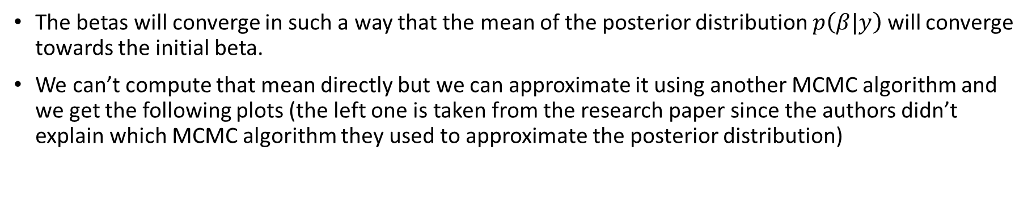

III. Simulating $β_{n}$for $p\left(β|y\right)$ using an exchange algorithm, assuming $α=0$ – Convergence
The betas will converge in such a way that the mean of the posterior distribution $p\left(β|y\right)$ will converge towards the initial beta.
We can’t compute that mean directly but we can approximate it using another MCMC algorithm and we get the following plots (the left one is taken from the research paper since the authors didn’t explain which MCMC algorithm they used to approximate the posterior distribution)
Evolution of the approximated mean of the posterior distribution, based on the betas obtained with the exchange algorithm
Source : Statistical Science 2015, Vol. 30, No. 4, 443–467
Evolution of the mean of betas with the number of iterations

Slide 15
Thank you for your attention !

